Slide 2
WELCOME

Slide 3

Web Scraping of IMDB (Animated Series)
Presenter :
Vamsi Trivikram

Slide 4
CONTENTS
Problem statements
Libraries used
Website used
Steps to collect and clean data.
Raw data collection and Cleaned data collection.
Data visualization
Events
Challenges faced and solution.
Conclusion
Web scraping

Slide 5
PROBLEM STATEMENTS :
Rating category distribution.
Display the most popular Certificate.
Find the most popular series based on Genre.
Density of Rating.
Display the top 10 series with respect to votes.
Maximum duration.
Display max. number of votes with respect to ratings.
Correlation

Slide 6
WEB SCRAPING :
Process of Extracting Data from a Website.
Approval (response).
Request to page.
Python library can be used to pull data out of HTML and XML files.

Slide 7
LIBRARIES USED
WEB SCRAPING
PYTHON
GOOGLE CHROME (INTERFACE)
BEAUTIFULSOUP
REQUESTS

Slide 8
DATA CLEANING AND MANIPULATION
PANDAS
NUMPY
REGULAR EXPRESSION

Slide 9
MATPLOTLIB
SEABORN
PLOTLY
DATA VISUALIZATIONS

Slide 10
IMDB WEBSITE FOR DATA COLLECTION

Slide 11
STEPS TO COLLECT DATA
Domain Selection .
Importing Libraries.
Scraping the raw data.
Data insertion and conversion.
Convert into csv file.

Slide 12
STEPS TO CLEAN DATA
Inspect the data frame.
Drop the duplicates.
Data type conversion.
For data visualization.

Slide 13
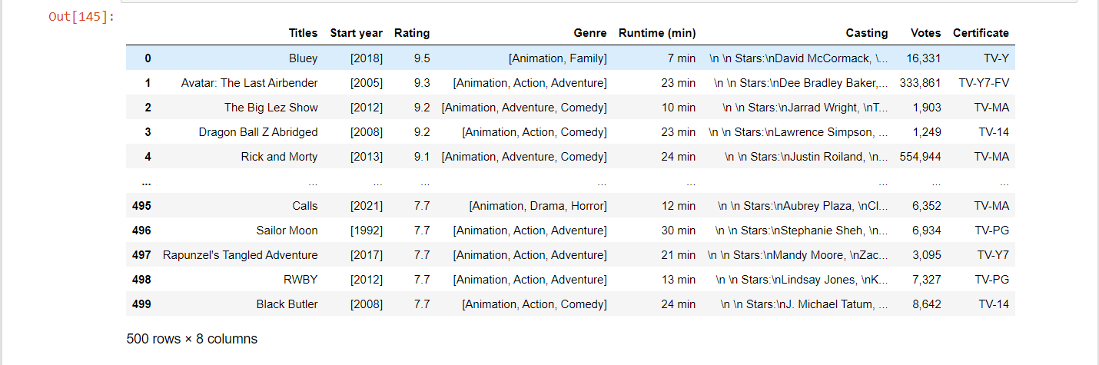
RAW DATA FROM IMDB SITE:

Slide 14
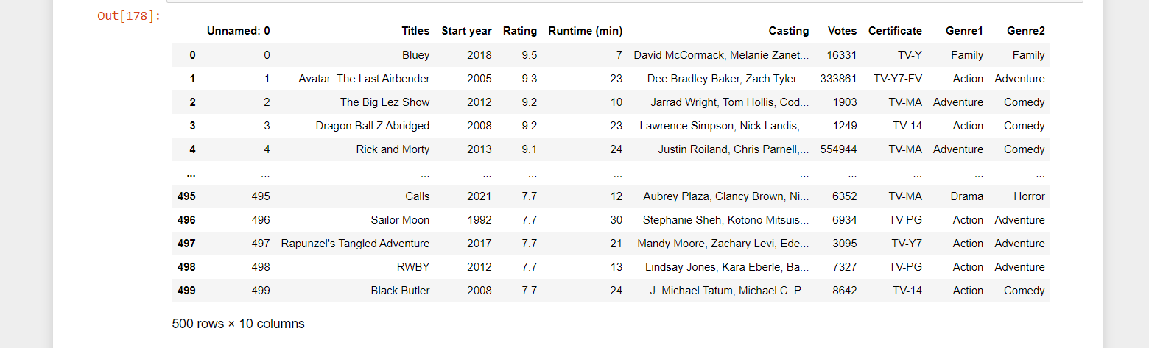
CLEANED DATA AFTER DATA CLEANING:

Slide 15
DATA VISUALIZATION
Univariate analysis:
- Categorical
- Numerical

Slide 16
Bivariate analysis:
Categorical & categorical.
Categorical & numerical.
Numerical & numerical.

Slide 17
Multi-variate analysis:
Two categorical & one numerical.
Two numerical & one categorical.
Three or more numerical.

Slide 18
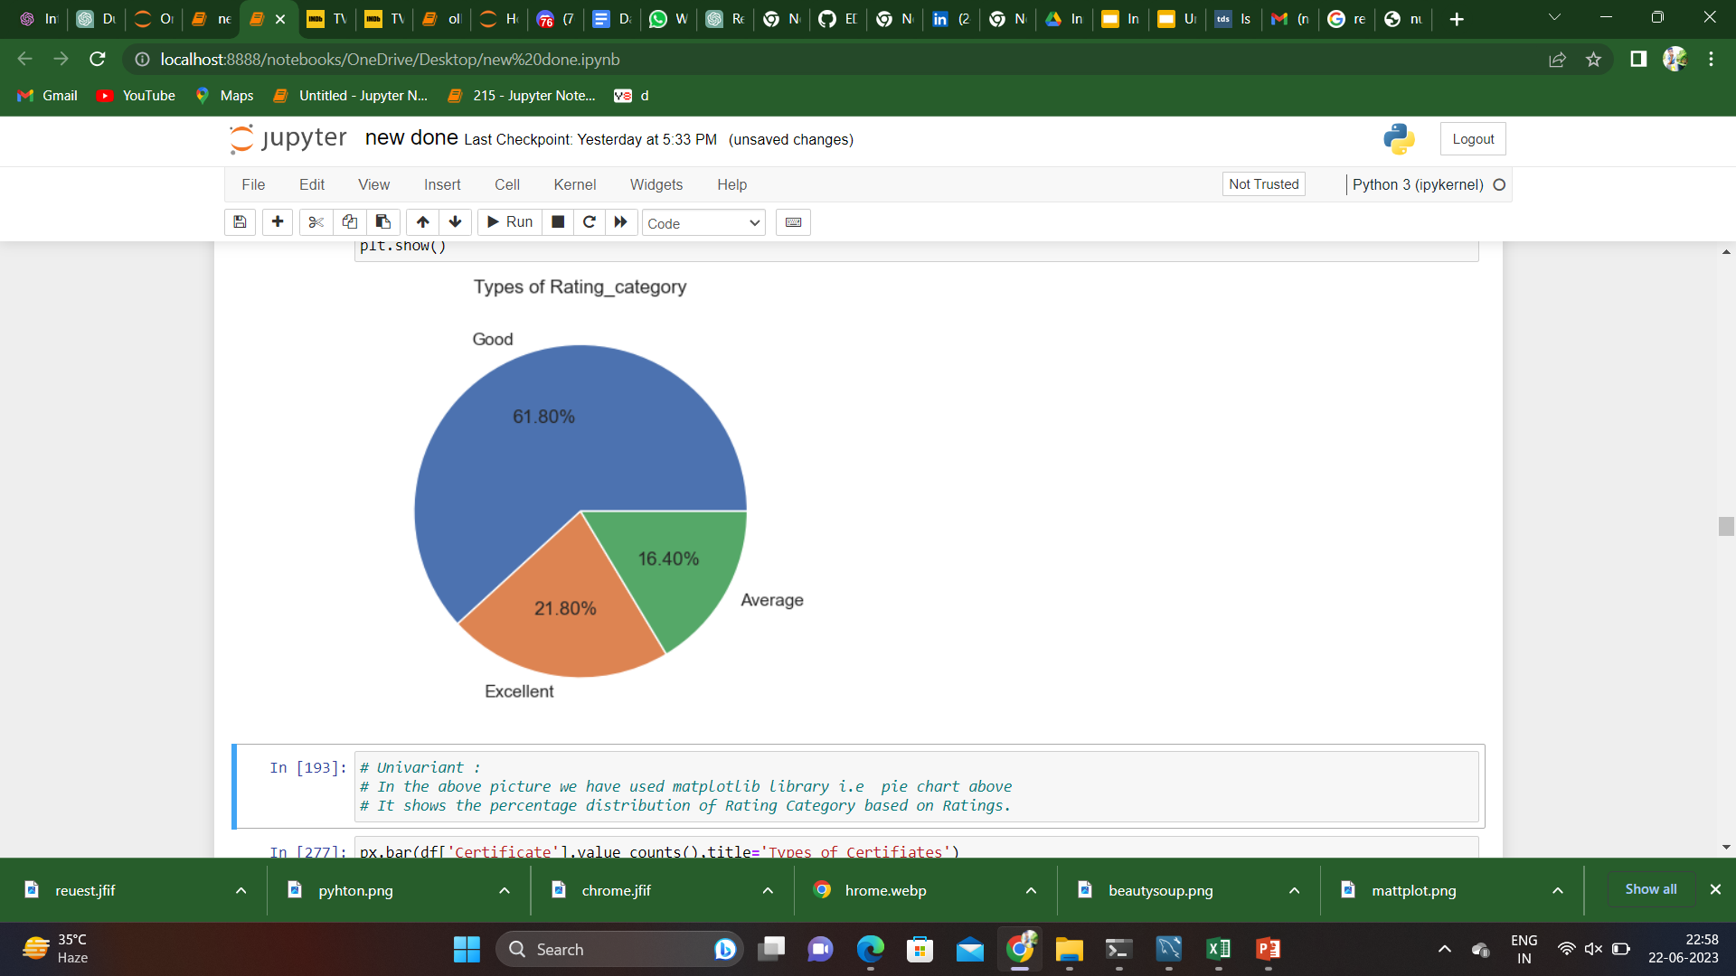

Rating category Distribution(Univariate-cat)

Slide 19
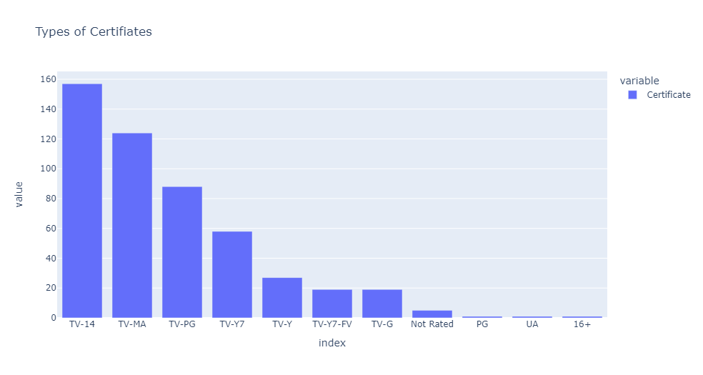
Types of CERTIFICATE (Univariate-cat)

Slide 20
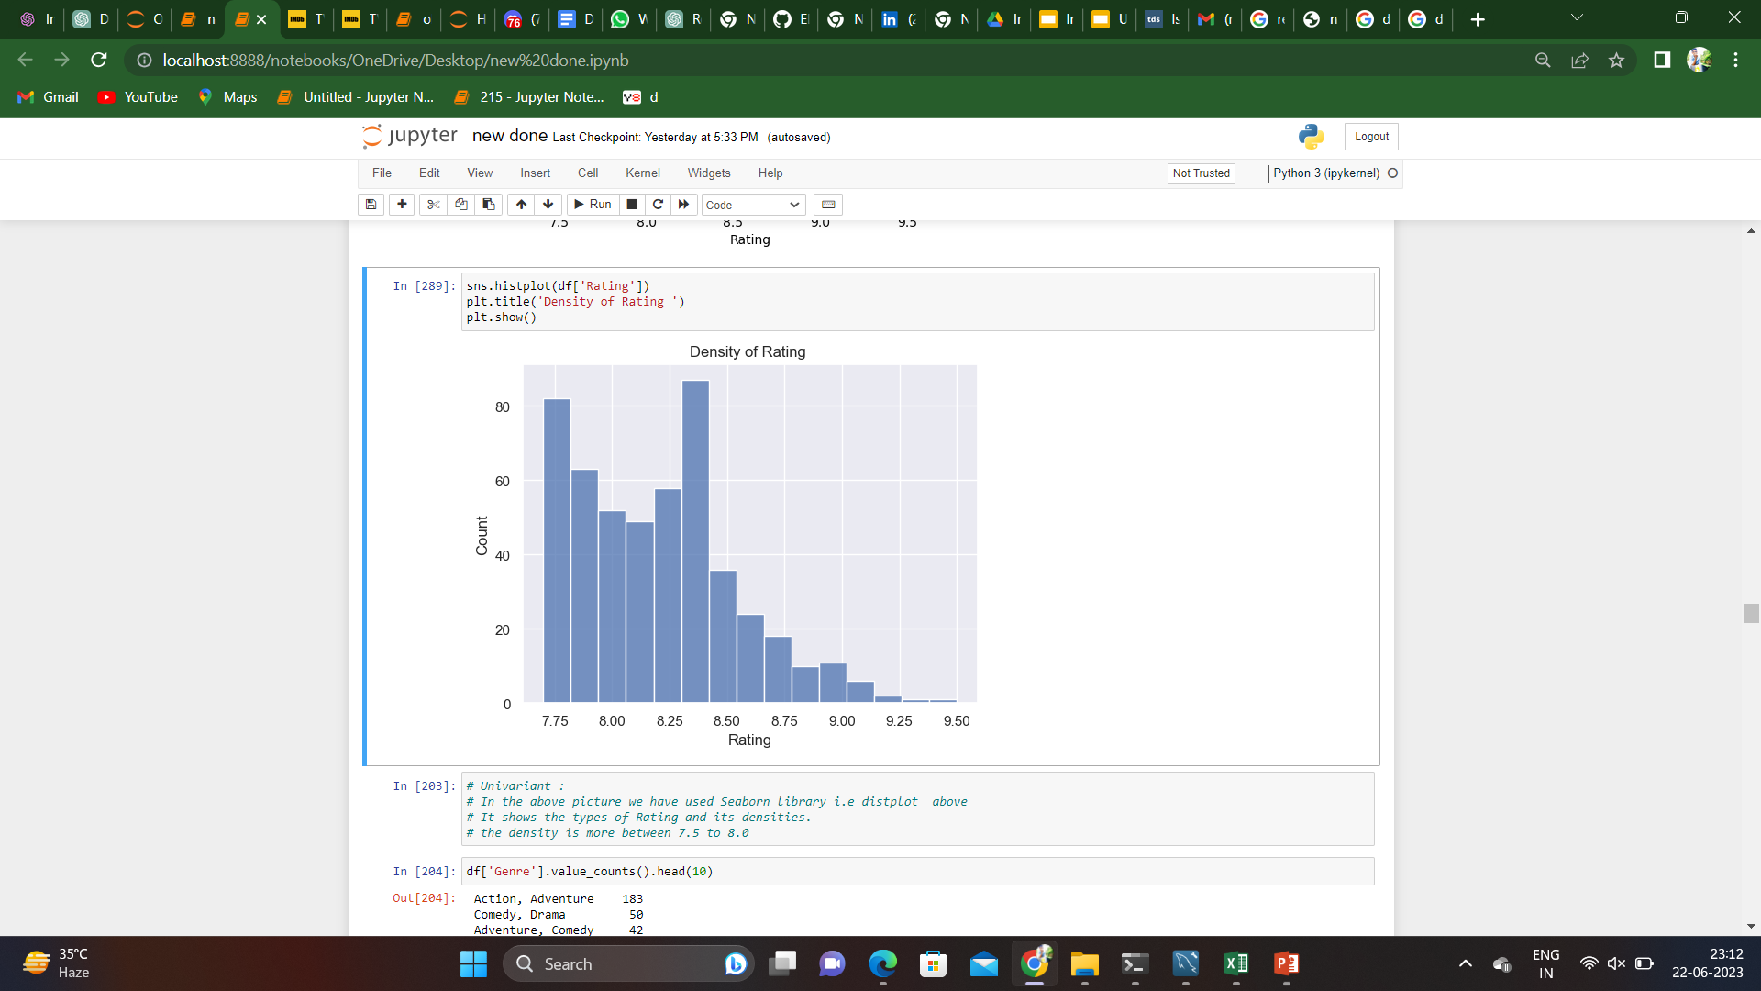
Density of Rating (Univariate-num)

Slide 21
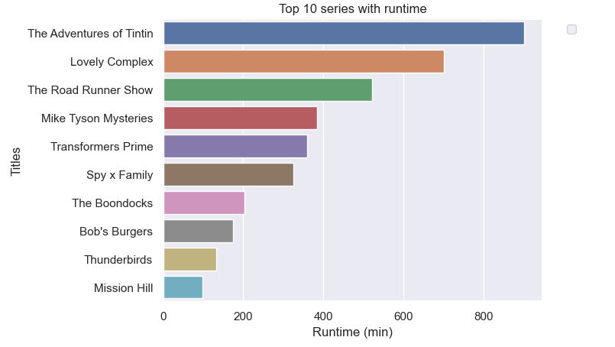
Longest Run series (Bivariate-Num vs Cat)

Slide 22
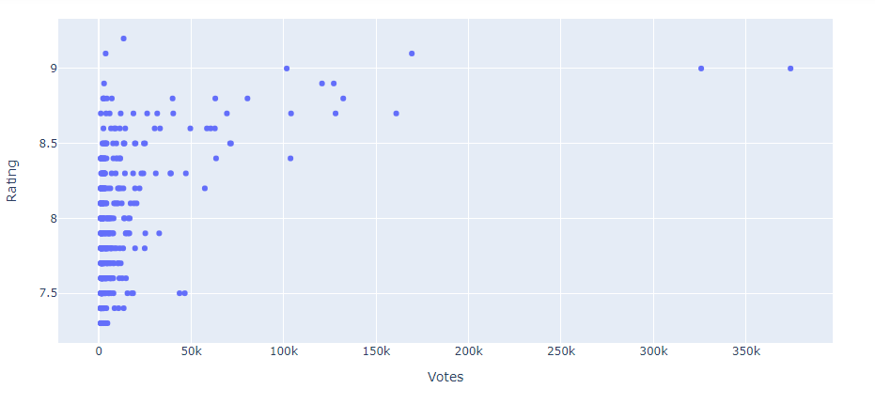
Density of votes with respect to Rating (Bivariate num vs num)

Slide 23
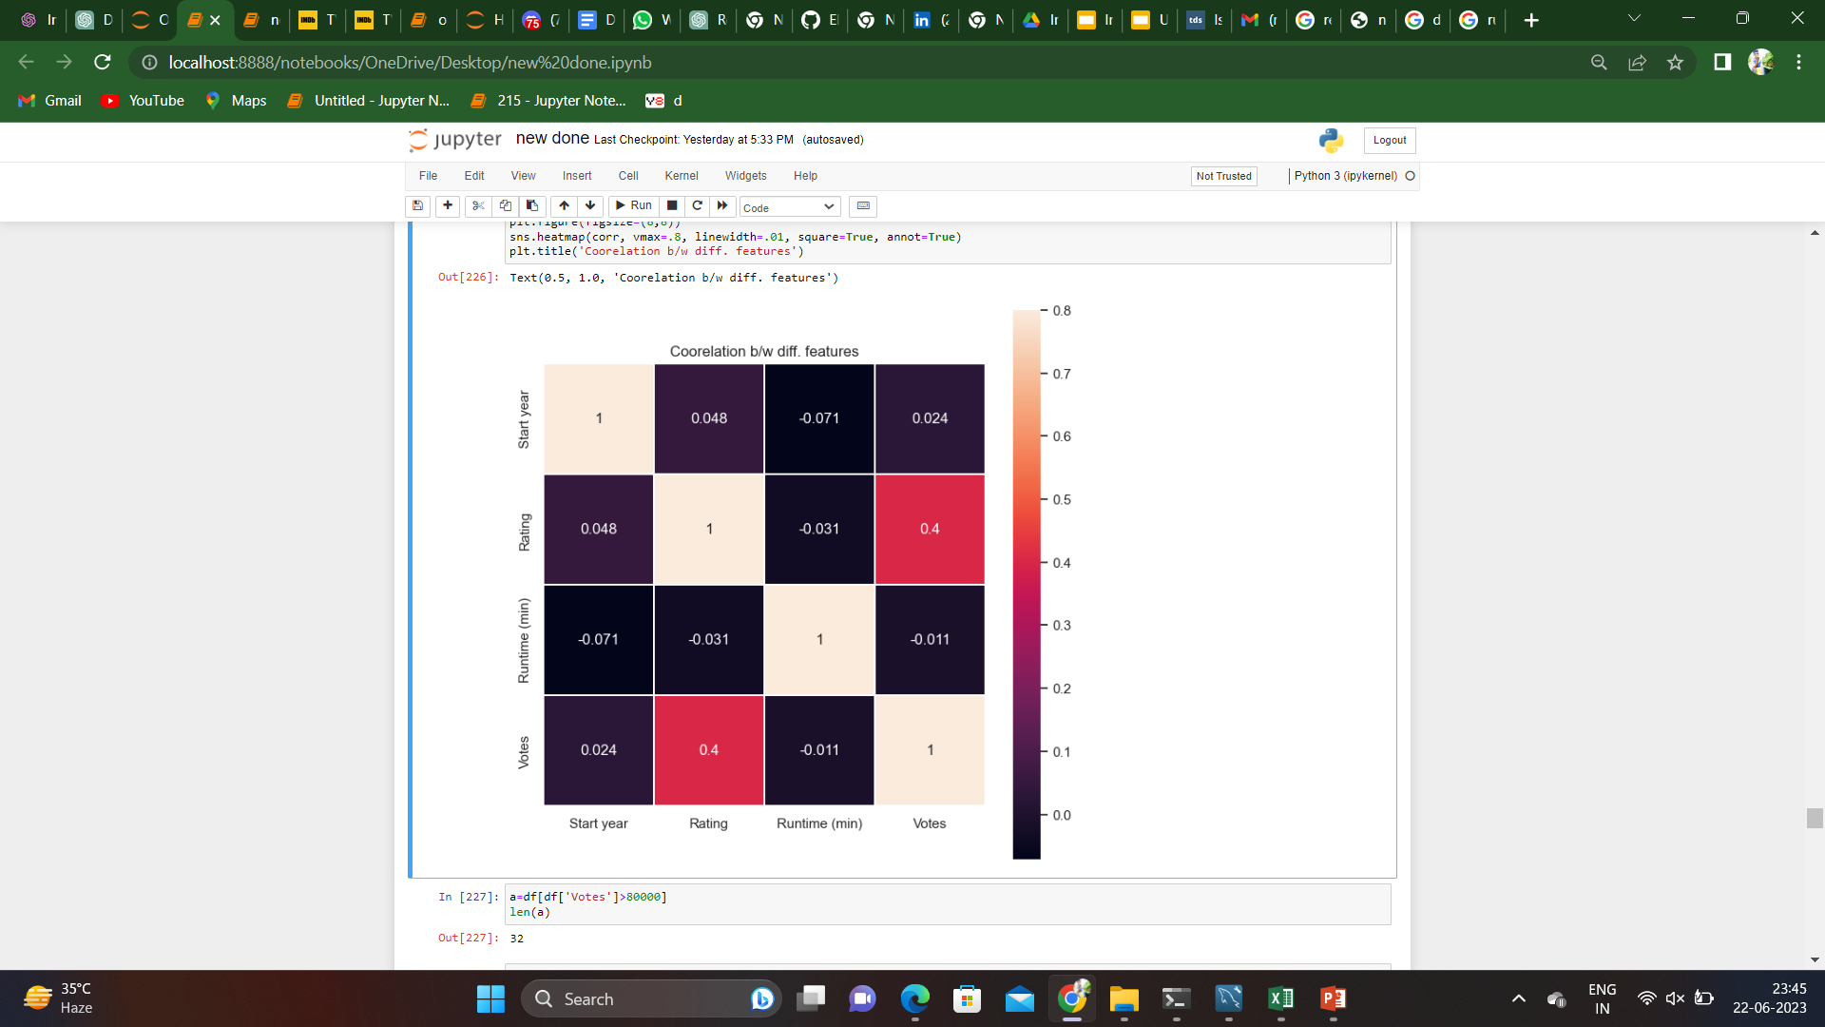
Correlation (Multivariate)

Slide 24
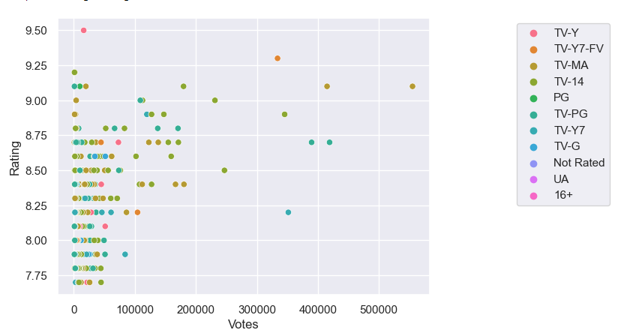
Max. number of votes with Rating, Certificates (Multivariate-num vs num vs cat)

Slide 25
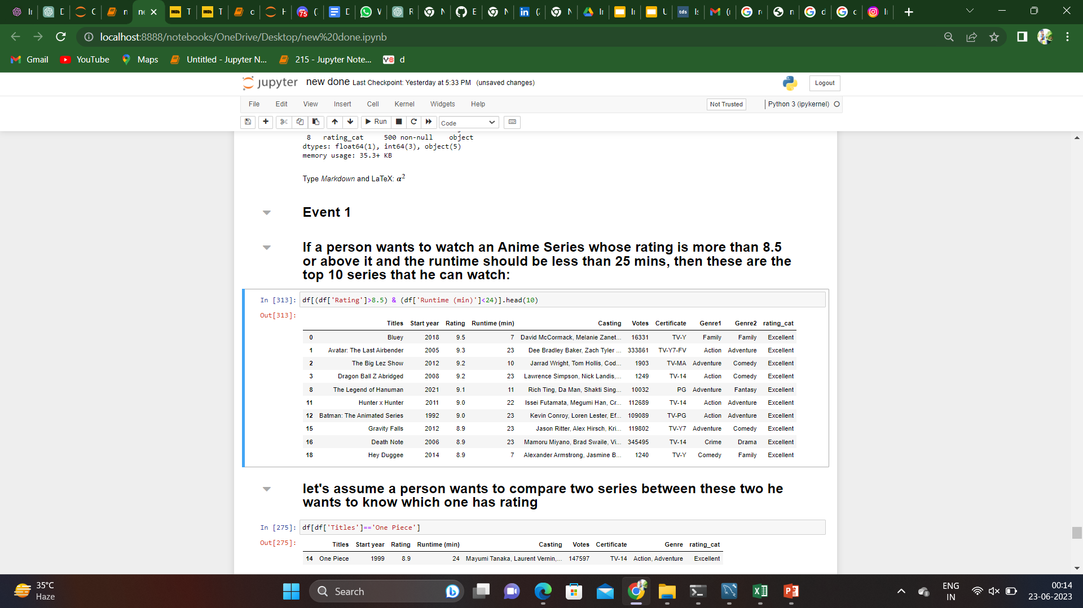
Event 1
If a person wants to watch an Anime Series whose rating is more than 8.5 or above it and the runtime should be less than 25 mins, then these are the top 10 series that he can watch:

Slide 26
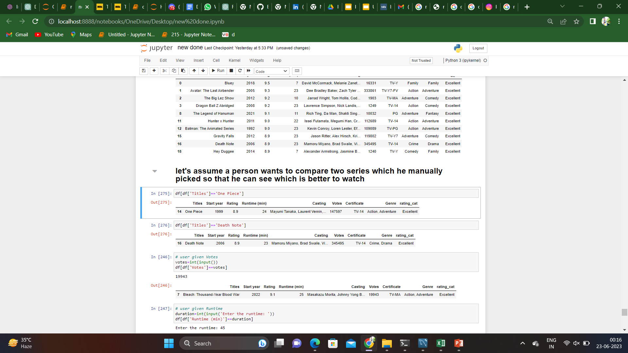
Event 2
Let's assume a person wants to compare two series which he manually picked so that he can see which is better to watch

Slide 27
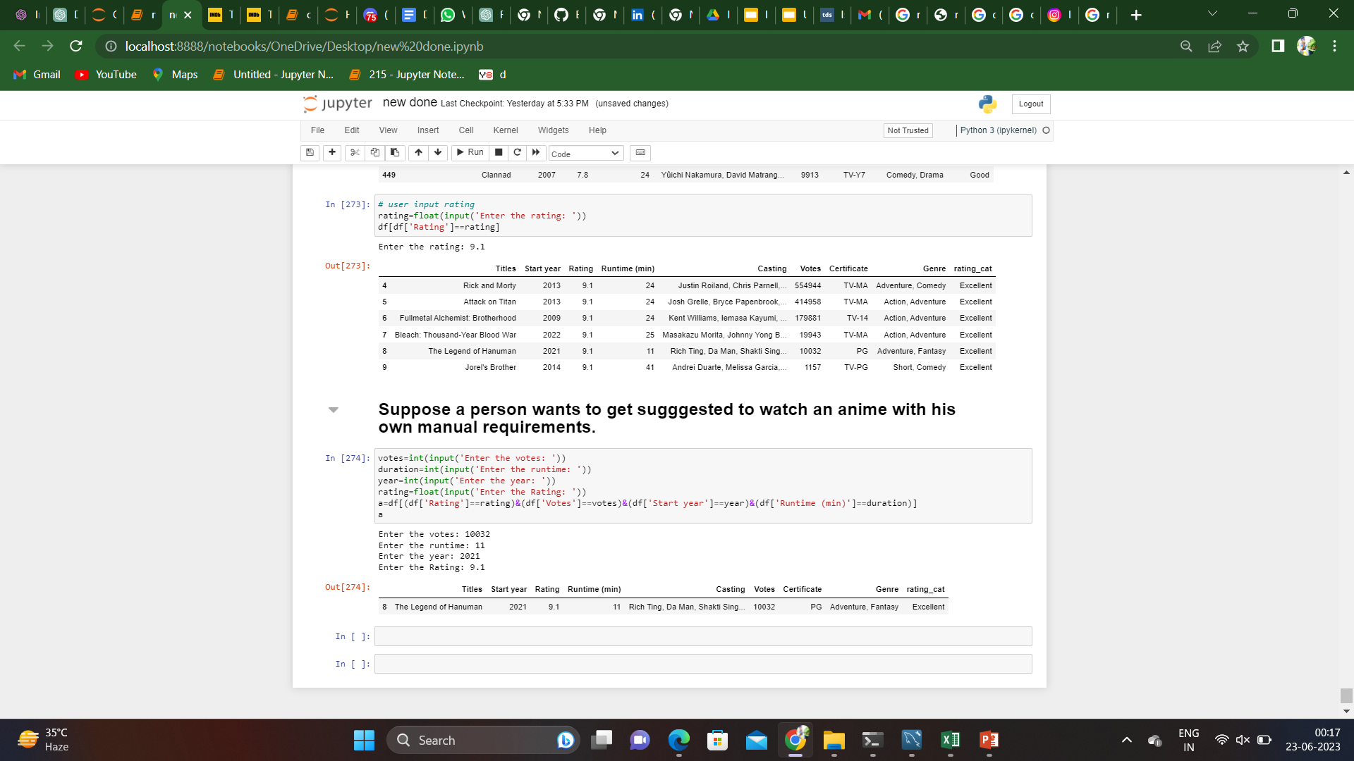
event 3
Suppose a person wants to get suggested to watch an anime with his own manual requirements.

Slide 28
Challenges Faced:
Inserting manually data at a specified location.
Losing Data all the time, whenever we restart the kernel.
Extracting link for each page.

Slide 29
Conclusion:
By Looking into the data we can know about Animated series and it’s types based on Genre, Rating, Votes etc.

Slide 30
THANK YOU!!!
HAVE A GREAT DAY

